Slide 1


FORTUNE MAKER
A full-stack project /......
Project
Fotune Maker(https://github.com/vaibhav0726/Fortune-Maker)

Slide 2

GLA UNIVERSITY
WEB DEVELOPMENT
Submitted to :
Submitted by :
AMIR KHAN
Vaibhav Varshney
Technical Trainer
201500766
Himanshu Kushwaha
201500215
Santosh Morya
201500620
Garima Gautam
201500242
Mradul Varshney
201500414

Slide 3




WEB DEVELOPMENT
FRONT-END
BACK-END
WEB D.
The part of a website that the
user interacts with directly.
It is the part of the website that
user cannot see and interact with..
It collects user input.It is respon
sible for accessibility, Search
Engine Optimization
It processes user inputs.
It is responsible for security, Backup.
The part of a website that the
user interacts with directly.
The part of a website that the
user interacts with directly.
It consists of a web server that
has a connection to the database
to reply to the requests.
next

Slide 4










WEB DEVELOPMENT
FRONT-END
BACK-END
next

Slide 5




Introduction
PROJECT SUMMARY
Fortune Maker
FORTUNE
MAKER
Aim is to Deliver each and every opportunity to everyone at just one click. An opportunity to Know , to score, to compete, to win and to prove yourself.
Fortune Maker is a Platform for all inter and intra collage to give freshers a great platform to learn and get their first job
next

Slide 6
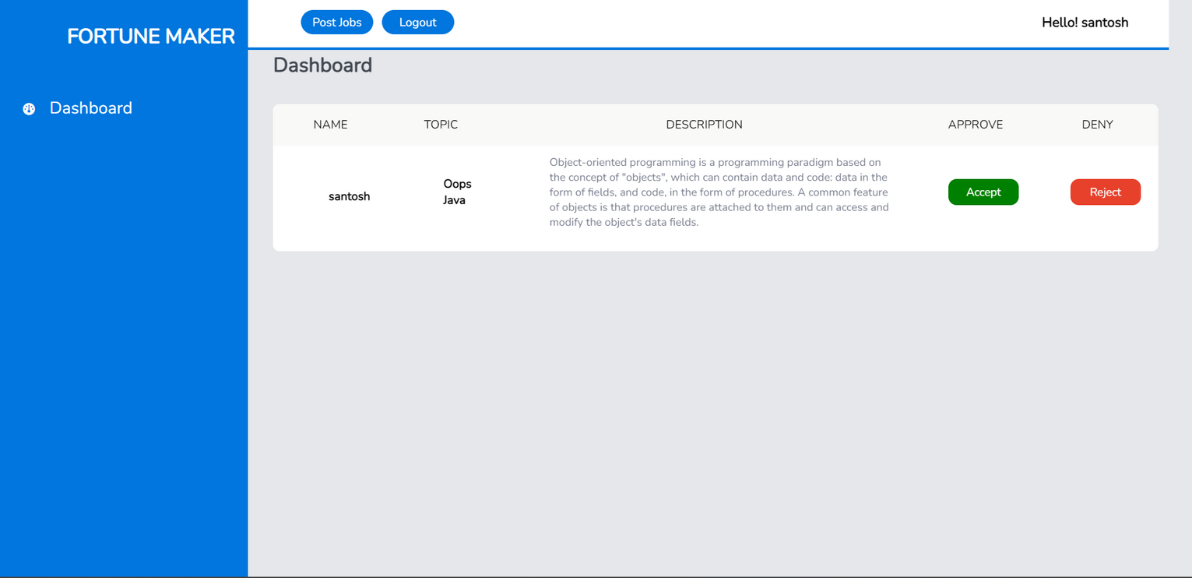
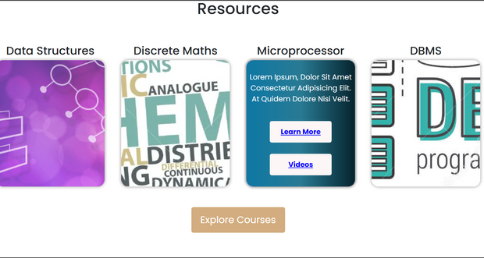

INTRODUCTION
Major Pages
Different tools are performing differently. We have shifted budget towards the most effective mediums and channels.
Home Page
Login Page
Resources
Job Portal
NEXT

Slide 7
WEBSITE MOCKUPS
Home
Page

Slide 8
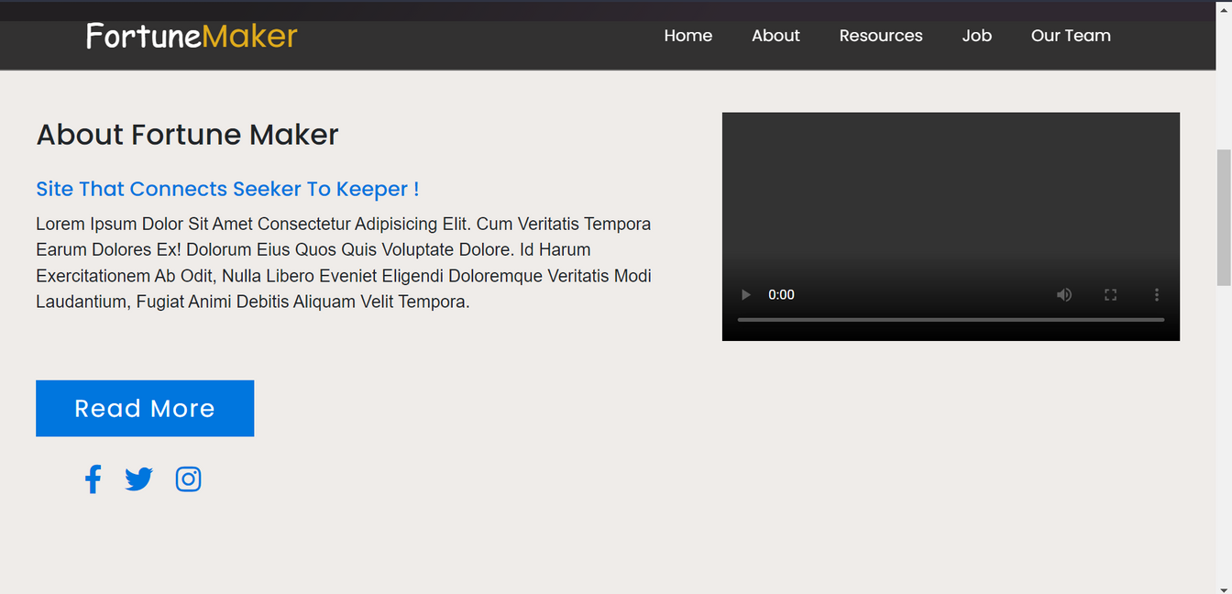
Website LOGO
Navigation Bar
Introduction Video

Slide 9

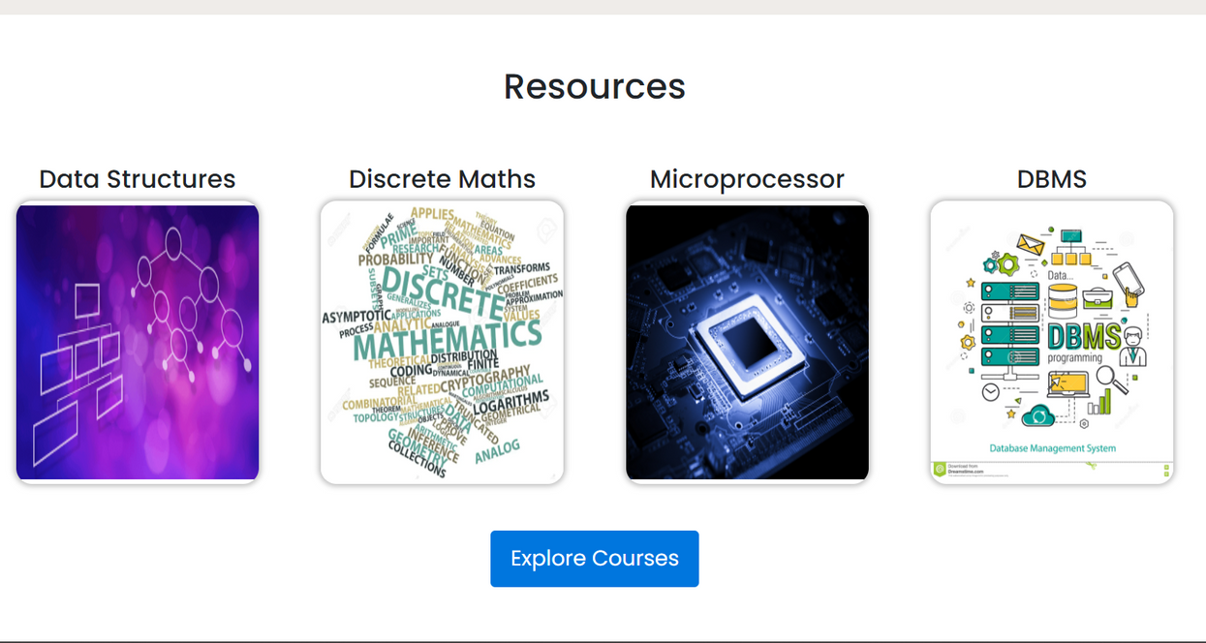
Title
Subject Name
Resources Cards
Button to redirect on Resource page

Slide 10


Title
Project Contributers

Slide 11
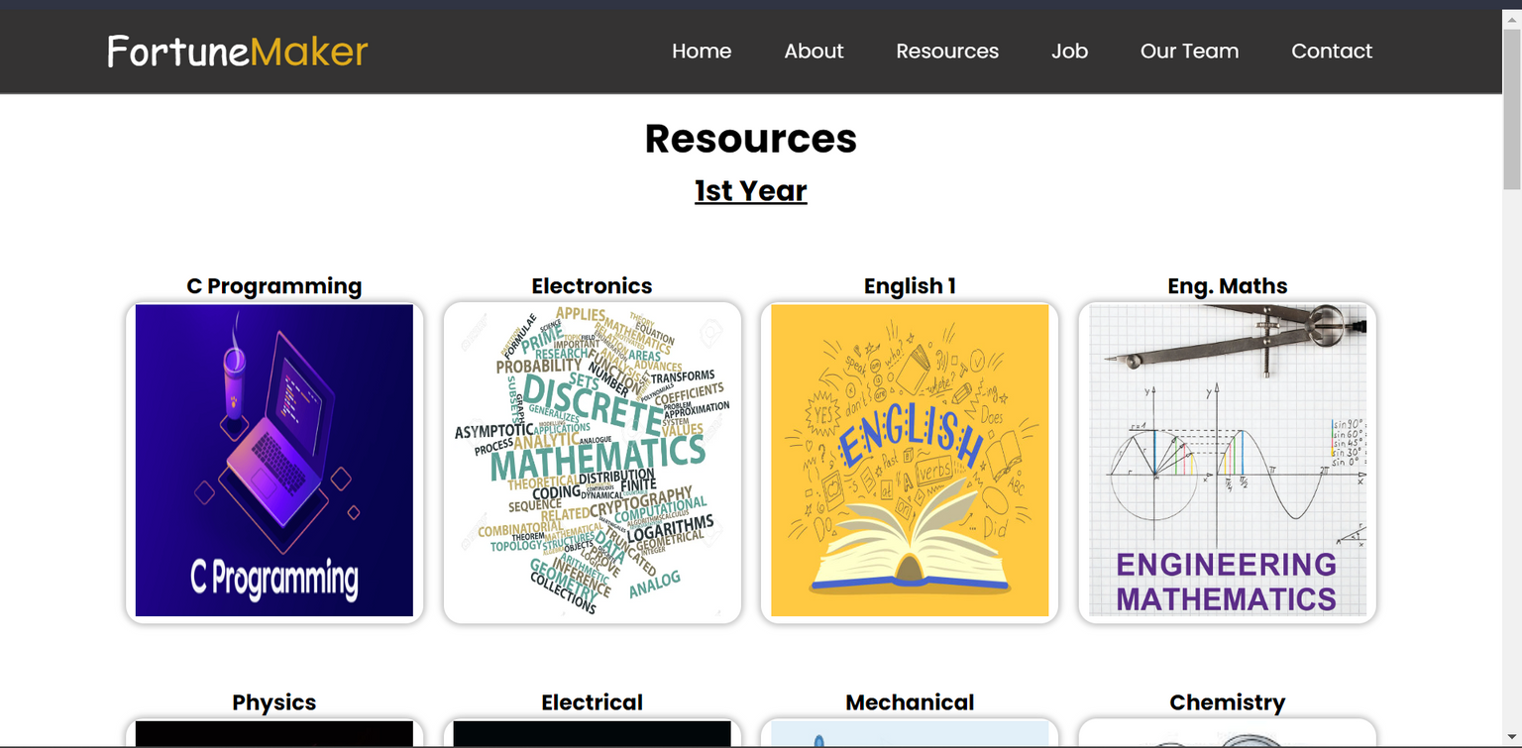
Title
Subject Name
Resources Cards

Slide 12
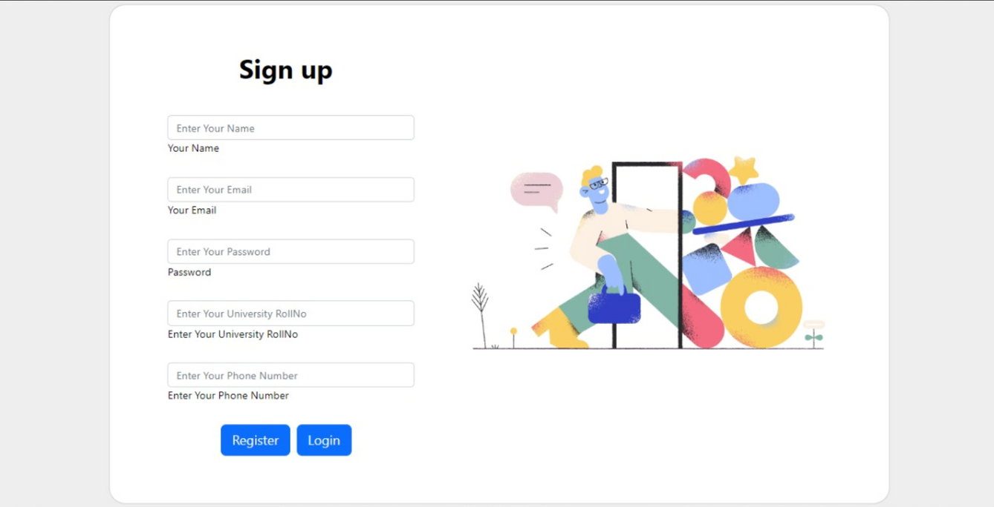
User
Registration

Slide 13
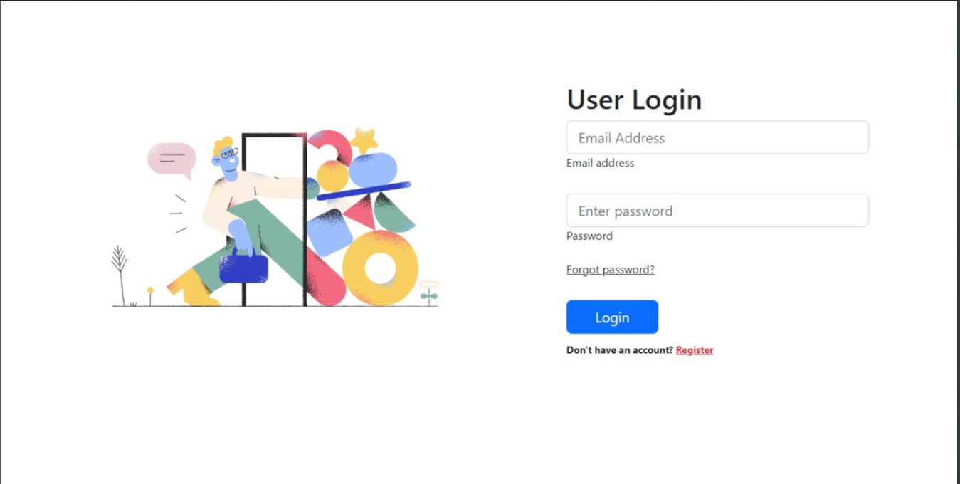
User
Login

Slide 14

Forget
Password
Here user can request a mail to reset password

Slide 15
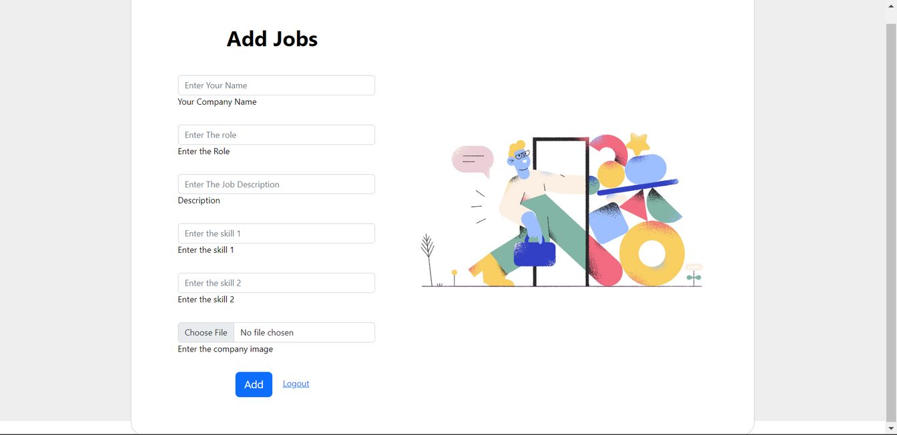
Jobs
Registration
Maintain by Admin
Add Jobs in list and Open Jobs in the page

Slide 16
JOB
Portal

Slide 17
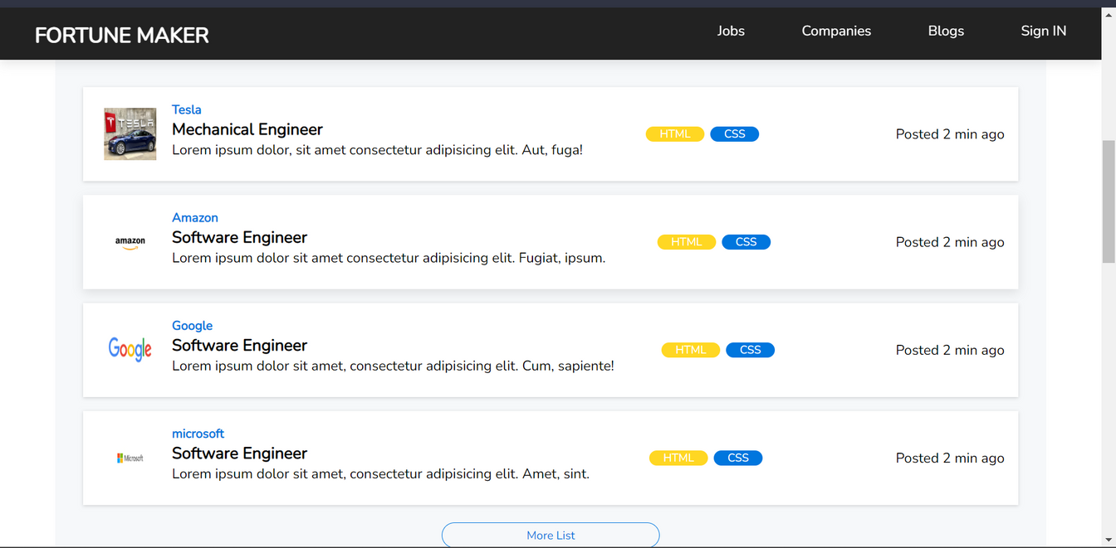
Current Opened Jobs List
All jobs Uploaded by companies

Slide 18
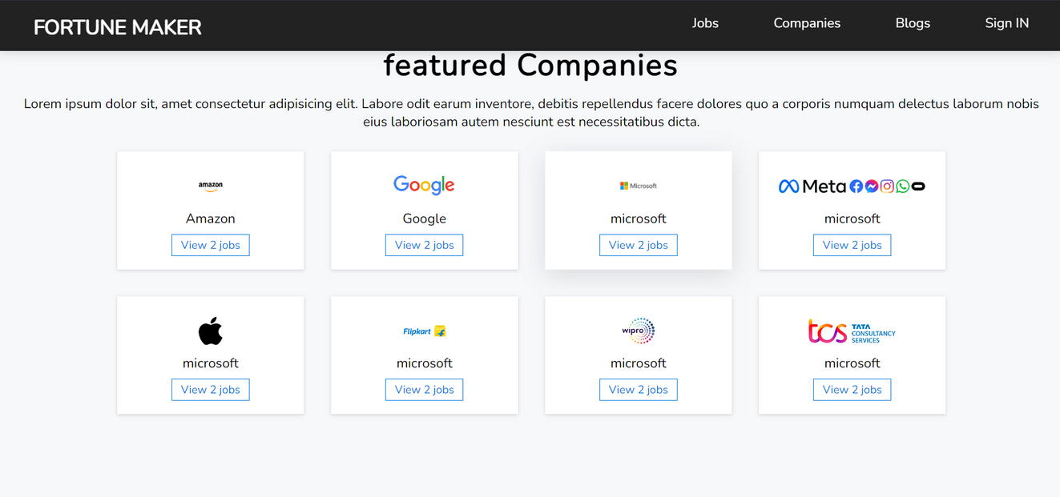
Top MNC's

Slide 19
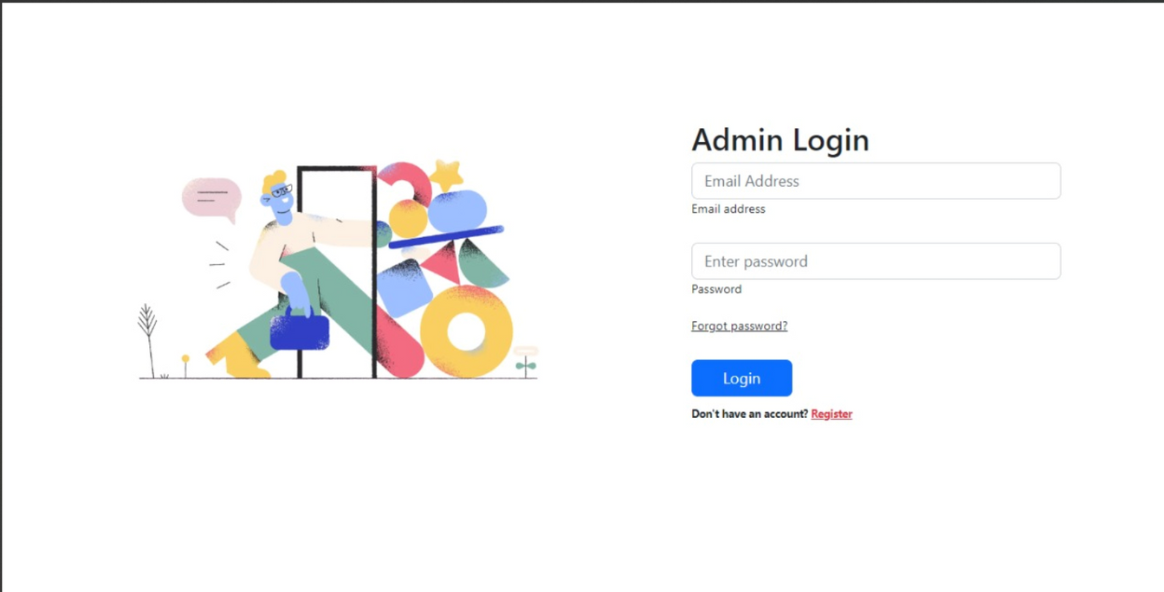
Admin
Login

Slide 20
Post jobs to Job Portal
Logout Button
Accept Button
Deny Button
Admin
Dashboard
Blog Post Requests

Slide 21
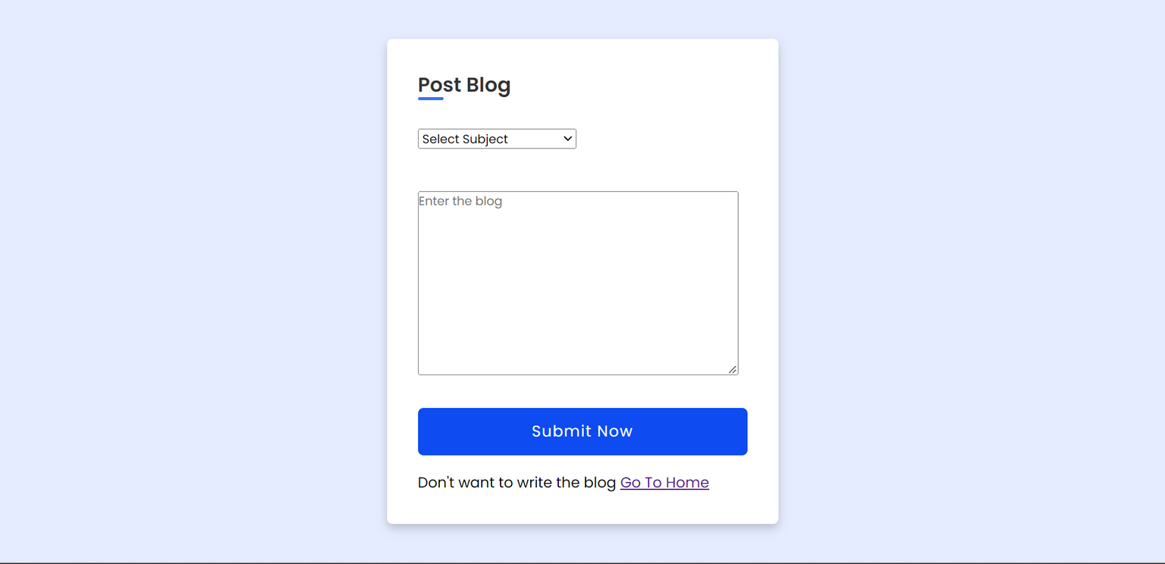
Blog Post
Request

Slide 22
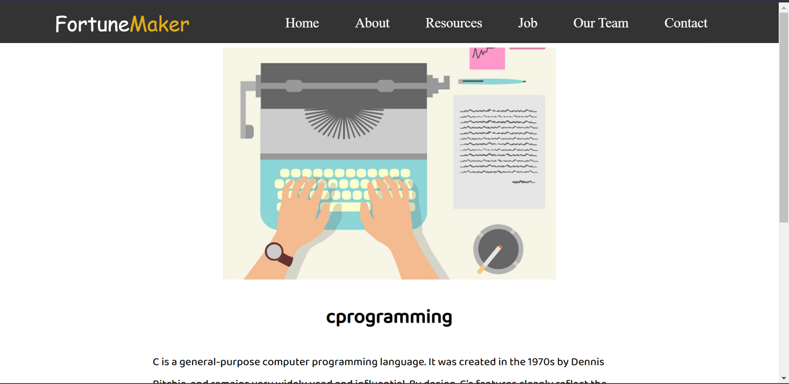
Blog
Page

Slide 23

Thank You !
Any Questions ?

